Slide 1


Seminar Presentation
CogAgent: A Visual Language Model for GUI Agents
Name of Student: MUHAMMED AL FAYAS N
University Register No: BJK23CS042
Name Of Guide: V. MANJU
Semester & Branch: S7, Computer Science Department
Department: Computer Science & Engineering
College: Bishop Jerome Institute
Academic Year: 2026–27

Slide 2
Introduction
•
Human-computer interaction is shifting rapidly from manual mouse/keyboard manipulation to intent-based AI assistance.
•
Standard text-based language models lack direct access to graphical user interfaces and visual spatial layouts.
•
Visual Language Models (VLMs) bridge this accessibility gap directly from raw screenshots and pixel data.
•
The proposed framework merges voice-driven conversational AI with native OS execution for seamless automation.
•
Addresses the growing need for autonomous digital agents capable of complex application navigation.

Slide 3
Objectives
•
Continuous Voice Interaction: Enable continuous, zero-latency voice-to-voice computer interaction.
•
Autonomous OS Control: Achieve full, autonomous system control over the entire desktop environment.
•
Generative Workflows: Automate complex generative workflows, including full codebase scaffolding and website creation.
•
Web Task Automation: Execute multi-step web tasks autonomously, such as online ticket booking and e-commerce transactions.
•
Expected Outcomes: Deliver a robust, secure, and privacy-preserving desktop assistant architecture.

Slide 4
Overview / Background
•
Brittle Scripts: Traditional script-based macros (like AutoHotkey or basic Selenium) break instantly during minor UI layout shifts or theme updates.
•
Isolated Environments: Standard language models operate in isolated sandboxes without hardware or screen hooks.
•
Human-Like Perception: High-resolution visual agents process screens naturally through image patches, just like human eyes.
•
Hybrid Perception: Advanced hybrid perception systems eliminate the need for hardcoded coordinate points and rigid XPath selectors.

Slide 5
Related Work / Literature Review
Author / Year | Work / Model | Key Findings & Contributions
Hong et al. (2024) | CogAgent | Dual-encoder VLM designed specifically for GUI environments, achieving state-of-the-art screen understanding.
Deng et al. (2023) | Mind2Web | Generalist web agents evaluated on complex cross-website navigation and multi-action task completion.
Rawles et al. (2023) | Android in the Wild (AITW) | Large-scale action-prediction models for mobile and touchscreen smartphone interfaces.

Slide 6
Technology / Methodology
•
UI Accessibility Trees: Utilizes native Windows UI Accessibility (UIA) trees for structured, zero-latency screen perception.
•
Fallback OCR: Employs local Optical Character Recognition (OCR) as a fallback mechanism for complex graphical canvases and non-standard UI elements.
•
Dynamic DPI Mapping: Applies dynamic DPI scaling to convert virtual model coordinates into exact physical hardware pixels.
•
Data Privacy: Maintains strict data privacy by leveraging lightweight, locally-hosted language models for sensitive desktop operations.

Slide 7
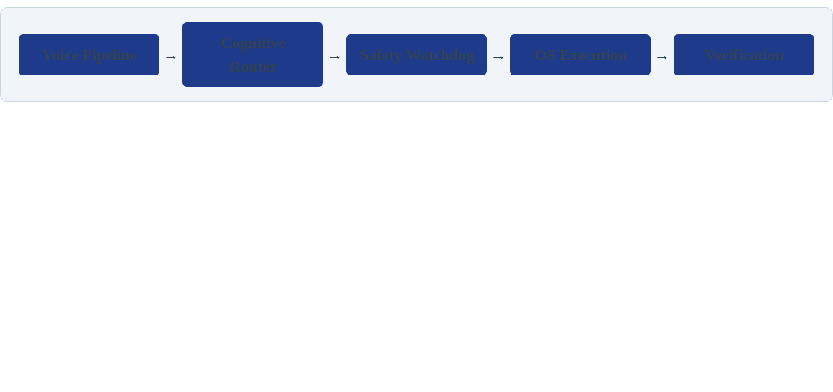
System Architecture / Block Diagram
•
Voice Pipeline: Translates audio to text and classifies user intent in real time.
•
Cognitive Router: Delegates tasks between local memory models and advanced cloud vision APIs.
•
Safety Watchdog: Rule-based gatekeeper that intercepts risky or destructive system commands.
•
Execution Layer: Synthesizes exact physical mouse clicks and OS keystrokes.

Slide 8
Detailed Discussion: Visual Grounding
•
AI maps conversational voice commands to exact screen coordinates using hybrid tracking algorithms.
•
UIA traversal identifies UI bounding boxes instantly without imposing heavy compute loads on the host system.
•
The integrated OCR engine parses text directly from non-standard or canvas-based application elements.
•
High-resolution visual attention modules recognize small interface components (icons, toggles, sliders) without losing inference speed.

Slide 9
Detailed Discussion: Autonomous OS
•
Translates single conversational prompts into multi-step execution graphs and dependency trees.
•
Controls native Windows functions, system settings, and application launching autonomously.
•
Dynamically navigates loading screens, software pop-ups, and unexpected GUI error dialogs.
•
Processes core desktop operations locally to maintain strict privacy and zero latency.

Slide 10
Detailed Discussion: Safety Gateways
•
Autonomous OS control introduces inherent risks of destructive file operations or accidental data deletions.
•
A Sentinel process watchdog continuously monitors system vitals and isolates execution threats.
•
The safety gatekeeper blocks the execution of unverified shell scripts and unauthorized registry modifications.
•
Post-flight verification visually checks screen state changes before executing subsequent click actions.

Slide 11
Applications
•
Generative Coding: Voice-triggered website scaffolding, codebase deployment, and automated testing workflows.
•
Web Automation: Hands-free online shopping, form filling, and autonomous travel ticket booking.
•
OS Navigation: Automated file organization, workspace management, and rapid software launching.
•
Assistive Technology: Seamless, hands-free desktop access for motor-impaired individuals.

Slide 12
Advantages
•
Highly hardware-efficient architecture runs securely on standard consumer laptops.
•
Operates independently of underlying HTML structure, scaling to any desktop software natively.
•
Local execution ensures complete data privacy for sensitive personal and enterprise workflows.
•
Eliminates heavy API token costs for routine, daily desktop operations.

Slide 13
Limitations & Challenges
•
The system is deeply coupled to the native Windows UI Automation framework APIs.
•
Custom game engines and pure canvas elements cause heavy local OCR processing loads.
•
Multi-monitor display setups complicate coordinate mapping and screen targeting accuracy.
•
High-resolution visual models demand heavily optimized local memory management.

Slide 14
Future Scope
•
Integration of on-device micro-VLMs to completely replace heavy OCR engines.
•
Expansion of native cross-platform support to Linux (AT-SPI) and macOS Accessibility APIs.
•
Development of self-healing UI selectors that adapt to DOM changes using execution logs.
•
Implementation of emotion-aware, dynamic voice synthesis for natural human interaction.

Slide 15
Conclusion
•
Visual Language Models effectively solve the limitations and rigidity of standard text-only AI assistants.
•
Hybrid architectures ensure zero-latency, highly secure, and private desktop control.
•
The system successfully automates complex real-world tasks like website creation and ticket booking.
•
This lays a realistic framework for sovereign, fully independent digital assistants in daily computing.

Slide 16
References
•
Hong, W., et al. (2024). CogAgent: A Visual Language Model for GUI Agents. CVPR.
•
Deng, X., et al. (2023). Mind2Web: Towards a Generalist Agent for the Web. arXiv preprint arXiv:2306.06070.
•
Rawles, C., et al. (2023). Android in the Wild: A Large-Scale Dataset for Device Control. NeurIPS.
•
Playwright Documentation (2024). API and Browser Automation Standards. Microsoft Open Source.
•
Microsoft Developer Network (2024). UI Automation Overview and Core Concepts. MSDN Docs.

Slide 17
THANK YOU
Questions & Discussion
MUHAMMED AL FAYAS N (BJK23CS042)
Bishop Jerome Institute

